Slide 1
Aakash Goel https://www.linkedin.com/in/goelaakash123/
Session 4:
Edge Detection and Line Detection
Acknowledgement: Slide Materials adopted from - Intro to Computer Vision (Cornell Tech); Noah Snavely, prepared by the lead instructor Prof S P Vimal , modified (added some content) by Aakash Goel

Slide 2
Topics
Edge Models & Approaches to edge detection
Hough Transform - Detecting Lines
Acknowledgement: Slide Materials adopted from - Intro to Computer Vision (Cornell Tech); Noah Snavely

Slide 3
What is an Edge ?
Analogy: Imagine a sharp boundary between two colored walls—one red and one white. That sharp change in color is like an "edge" in an image.
Definition: An edge is a region in an image where intensity changes sharply. It's the boundary between objects, textures, or colors.

Slide 4
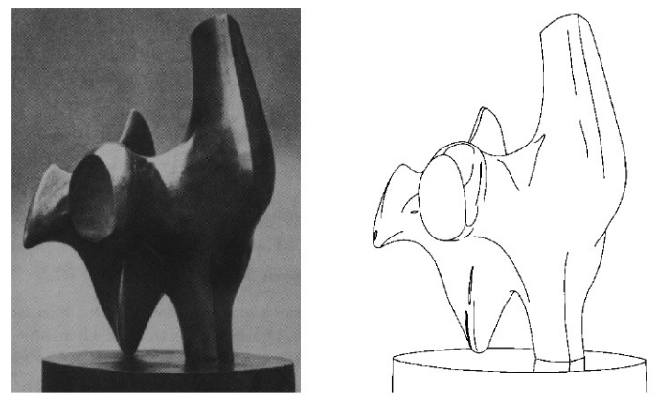
Edge Detection
Task : Convert a 2D image into a set of curves (made of edges)

Slide 5
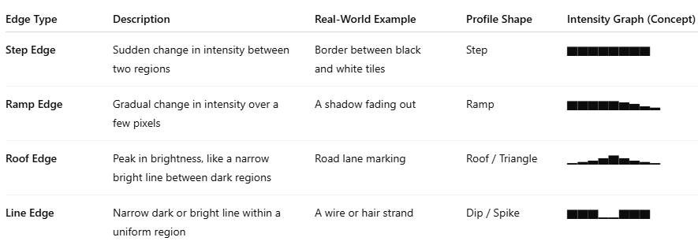
Edge Profiles
An Edge Profile describes how the pixel intensity changes across an edge in an image.
Think of it like a graph of brightness as you move across a line in the image. This helps us understand how sharp or gradual an edge is.

Slide 6

Edge Profiles
Step Edge Ramp Edge Roof Edge

Slide 7
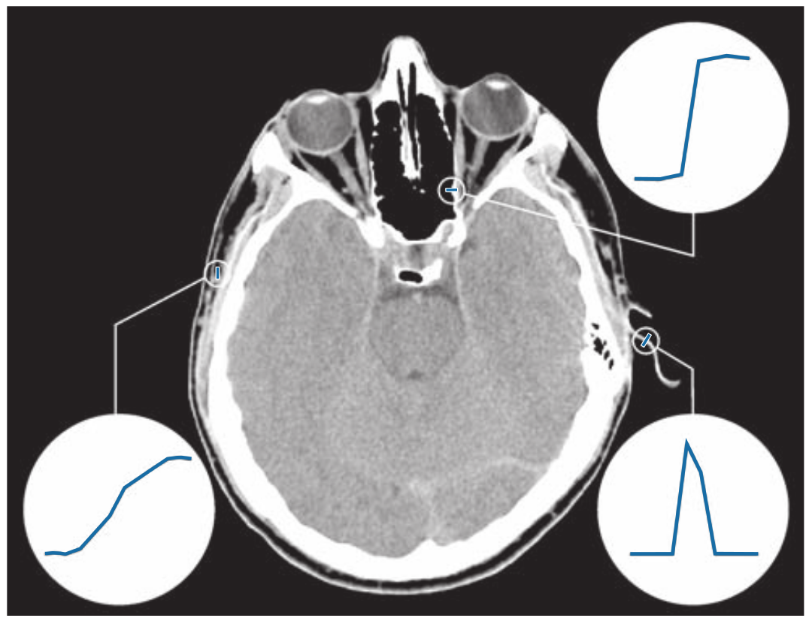
Example
CV 4: Edge and Line Detection
A 1508 1970 × image showing (zoomed) actual ramp (bottom, left), step (top, right), and roof edge profiles. The profiles are from dark to light, in the areas enclosed by the small circles. The ramp and step profiles span 9 pixels and 2 pixels, respectively. The base of the roof edge is 3 pixels. (Original image courtesy of Dr. David R. Pickens, Vanderbilt University.)

Slide 8
Edge Detection Approach
Category | Description
Gradient-based | Detect edges by checking sharp intensity change
Laplacian-based | Uses second derivative for sharper detection
Model-based | Fit lines or curves through edge data

Slide 9
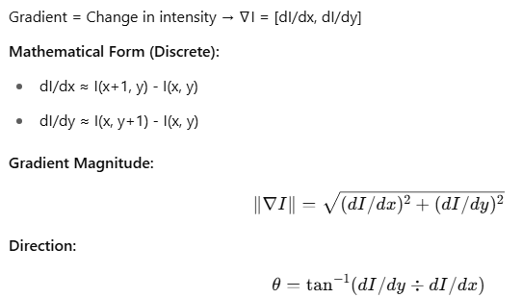
What is Gradient in Image processing ?
A gradient in an image tells us how much the intensity (brightness) is changing and in which direction it is changing.
If you think of an image as a landscape, the gradient shows how steep the hill is at any point and which way is uphill.

Slide 10
Example (1D) - Gradient
Imagine a Row of Pixels (1D)
[50, 52, 55, 60, 90, 130, 132, 133]
We can see a rapid change in values from 60 → 90 → 130. That’s where an edge exists.
Mathematically, we calculate the gradient by subtracting neighbor values:
Gradient ≈ Right – Left
Example:
At pixel 3 (value = 60):
Gradient ≈ 90 - 55 = 35 → High gradient → Edge
At pixel 1 (value = 52):
Gradient ≈ 55 - 50 = 5 → Low gradient → No edge

Slide 11
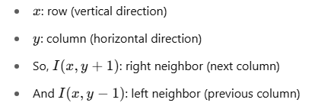
Example (2D) - Gradient
In 2D Images: Gradient in X and Y Directions
Each pixel has 2 neighbors in X-direction (left-right) and 2 in Y-direction (top-bottom).
Gradient in X:
Gx = I(x, y+1) - I(x, y-1)
Gradient in Y:
Gy = I(x+1, y) - I(x-1, y)
Magnitude of gradient = √(Gx² + Gy²)
Direction = arctangent(Gy / Gx)
This tells us how strong the edge is, and in which direction it points.

Slide 12
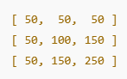
Example (2D) - Gradient
We want to compute the gradient at the center pixel (100).
Gx = Right - Left = 150 - 50 = 100
Gy = Bottom - Top = 150 - 50 = 100
Now:
Magnitude = √(100² + 100²) = √20000 ≈ 141
Direction = arctan(1) = 45°
This means there's a strong edge going diagonally from top-left to bottom-right.

Slide 13
Using Sobel Operator (More Stable than Simple Difference)
The Sobel Operator is a better way to calculate gradients. It uses weighted differences:
It combines:
Differentiation (to detect edges)
Smoothing (to reduce noise)
https://pyimagesearch.com/2021/05/12/image-gradients-with-opencv-sobel-and-scharr/

Slide 14
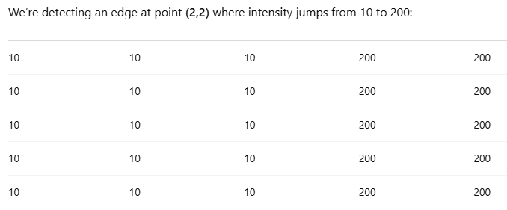
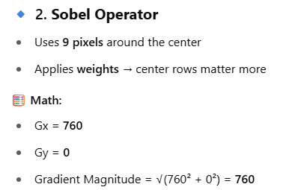
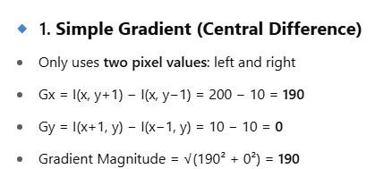
EXAMPLE – Naive Gradient Vs. Sobel
Imagine trying to detect a crack in a wall using just your left and right view (simple gradient) vs. using a 360-degree scan with depth sensors (Sobel). Which one gives a better idea of where the crack begins and ends?

Slide 15
EXAMPLE – Naive Gradient Vs. Sobel
Sobel (760) | Simple Difference (190)
Uses multiple pixels | Uses only 2 pixels
Adds weight to neighbors | No context awareness
Emphasizes structure and direction | Only abrupt change
Better at finding real edges | Sensitive to noise

Slide 16
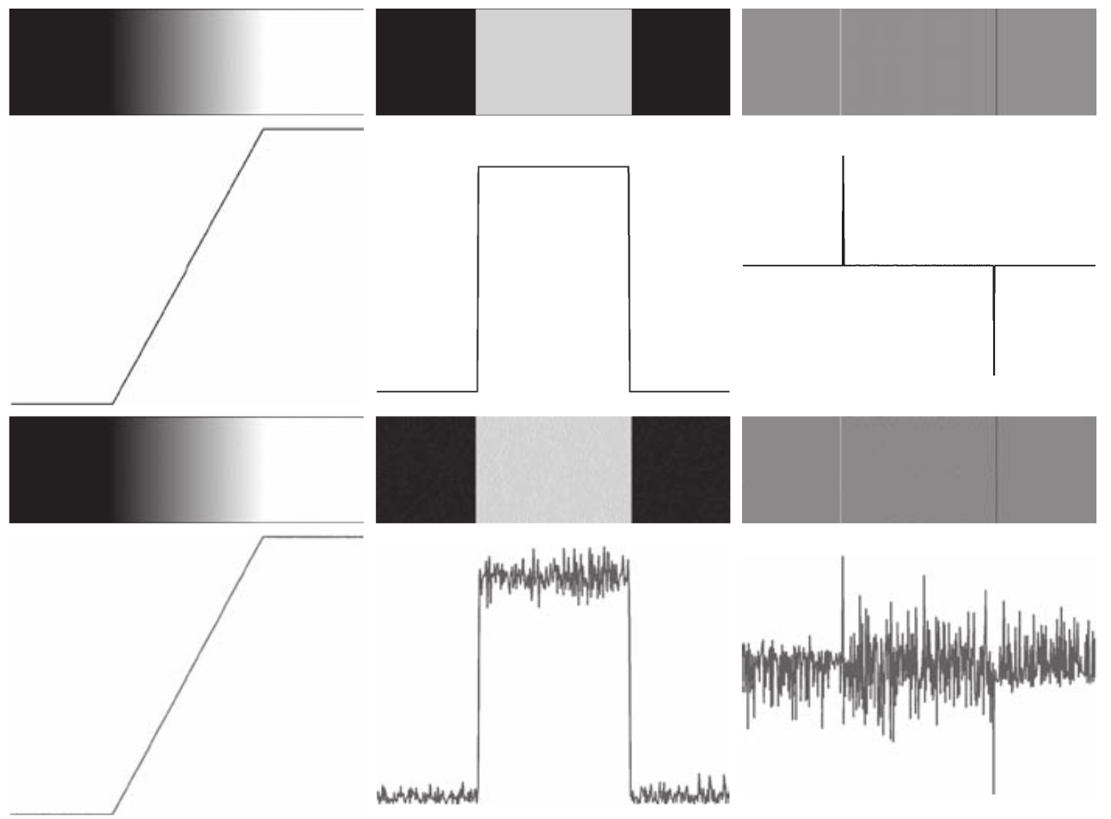
Edge
Detection
Approach
CV 4: Edge and Line Detection
First column: 8-bit images with values in the range [ , ], 0 255 and intensity profiles of a ramp edge corrupted by Gaussian noise of zero mean and standard deviations of 0.0, 0.1, 1.0, and 10.0 intensity levels, respectively. Second column: First-derivative images and intensity profiles. Third column: Second-derivative images and intensity profiles.

Slide 17
Edge
Detection
Approach
1. Image smoothing for noise reduction.
2. Detection of edge points. As mentioned earlier, this is a local operation that extracts from an image all points that are potential edge-point candidates.
3. Edge localization. The objective of this step is to select from the candidate points only the points that are members of the set of points comprising an edge.

Slide 18
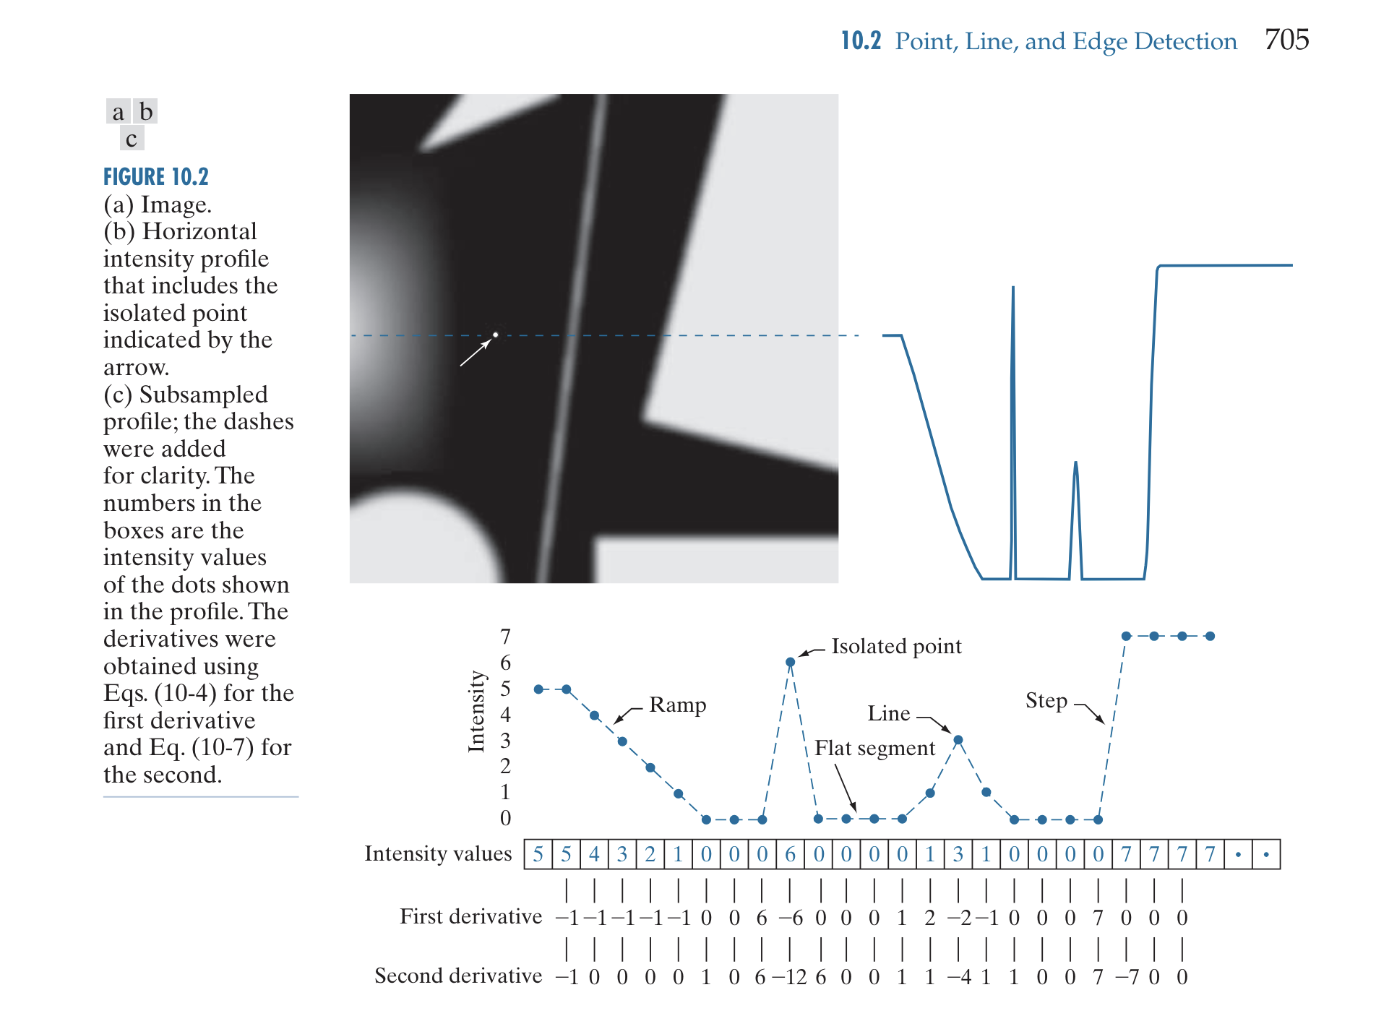
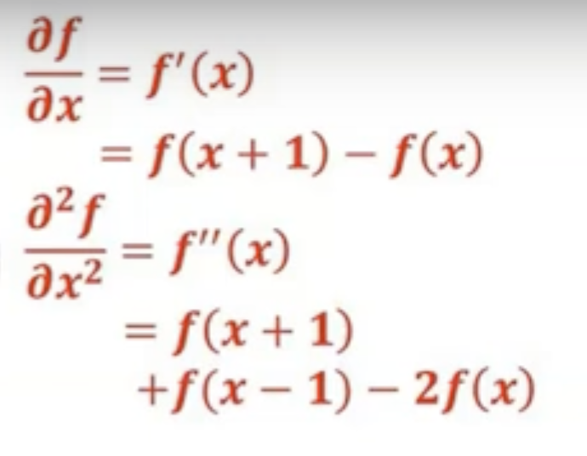
Image credit Digital Image Processing, 4th Ed, Rafael C. Gonzalez & Richard E. Woods

Slide 19
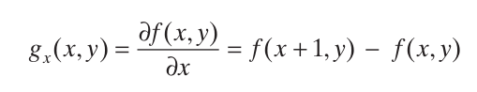
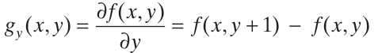
Gradient and it’s Computation
How can we differentiate a digital image F[x,y]?
Option 1: reconstruct a continuous image, f, then compute the derivative
Option 2: take discrete derivative (finite difference)

Slide 20
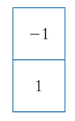
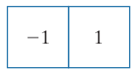
Gradient and it’s Computation
y
x
How can we differentiate a digital image F[x,y]?
Option 1: reconstruct a continuous image, f, then compute the derivative
Option 2: take discrete derivative (finite difference)
(a)
(b)

Slide 21
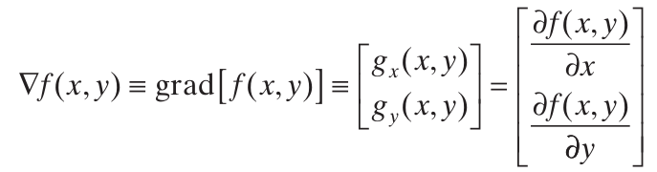
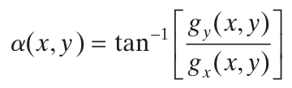
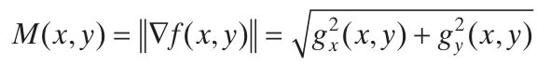
Gradient and it’s Computation
Compute partial derivatives ∂f/∂x and ∂f/∂y at every pixel location in the image
Points in the direction of maximum rate of change of f at ( x, y)
Direction of gradient vector at ( x, y)
Value of the rate of change in the direction of the gradient vector at ( x, y)

Slide 22
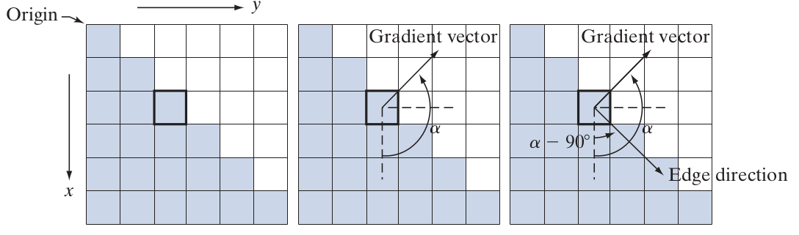
Gradient and it’s Computation - Example
The shaded pixels are 0’s & white are 2’s

Slide 23
Gradient and it’s Computation - Example
The shaded pixels are 0’s & white are 2’s
Subtract pixels in the top row of the neighborhood from the pixels in the bottom row → partial derivative in the x-direction
Subtract pixels in the left column from the pixels in the right column of the neighborhood → partial derivative in the y-direction

Slide 24
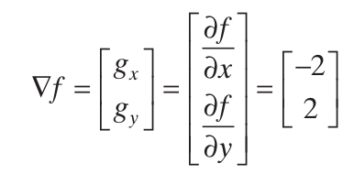
Gradient and it’s Computation - Example
The shaded pixels are 0’s & white are 2’s
= -2
= 2

Slide 25
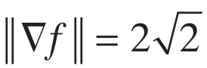
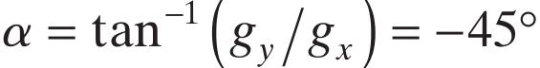
Gradient and it’s Computation - Example
The shaded pixels are 0’s & white are 2’s
= 135º

Slide 26
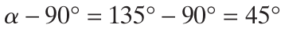
Gradient and it’s Computation - Example
The shaded pixels are 0’s & white are 2’s
Direction of an edge at a point is orthogonal to the gradient vector at that point ⇒ Direction of Edge is
= 135º

Slide 27
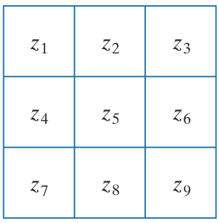
Gradient and it’s Computation - Different Forms
A 3 × 3 region of an image (the z’s are intensity values)
To Do: Compute
gradient at z₅

Slide 28
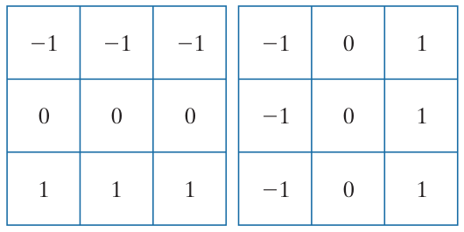
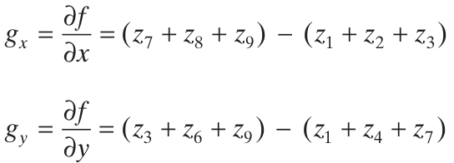
Gradient and it’s Computation - Different Forms
Prewitt’s operators
A 3 × 3 region of an image (the z’s are intensity values)
To Do: Compute
gradient at z₅

Slide 29
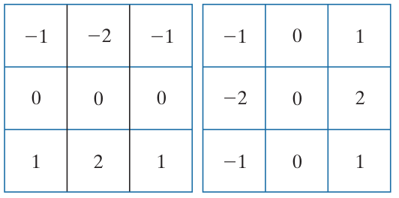
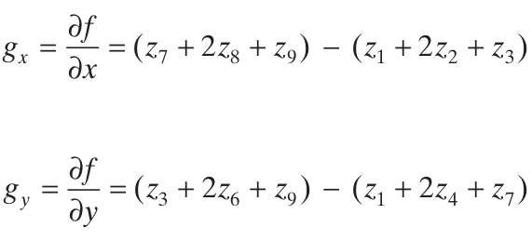
Gradient and it’s Computation - Different Forms
Sobel’s operators
A 3 × 3 region of an image (the z’s are intensity values)
To Do: Compute
gradient at z₅

Slide 30
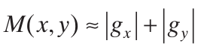
Gradient and it’s Computation - How to use?
Use any of the gradient operators to obtain g_{x} and g_{y} at every pixel location
Approximate gradient at each of the pixel locations as below:

Slide 31
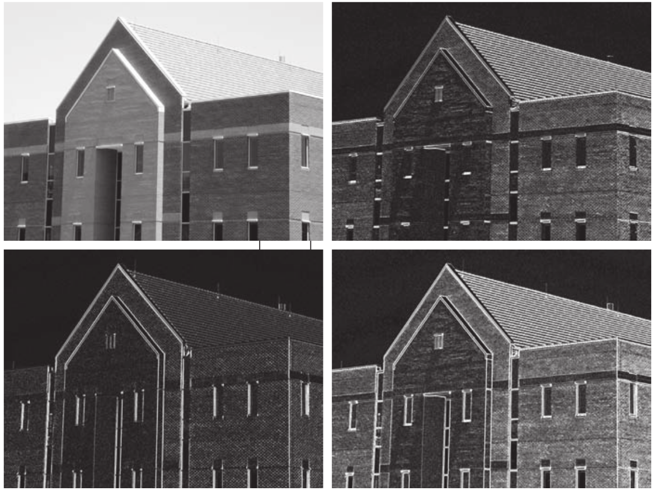

Gradient and it’s Computation - Example
(a) Image of size 834 × 1114 pixels,
with intensity values scaled to [0, 1].
(b) |g_{x}|, the component of gradient
obtained using the Sobel kernel
(c) |g_{y}|
(d) The gradient (using sum of absolute values )

Slide 32
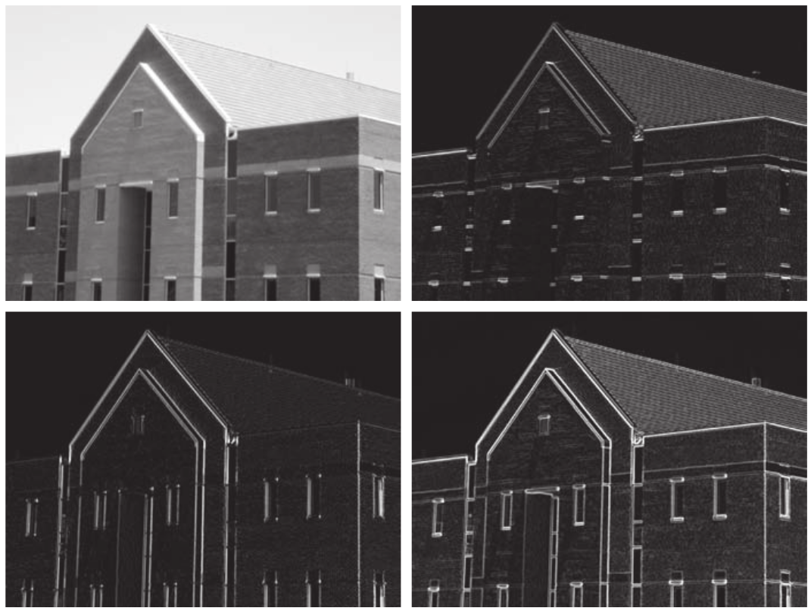
Gradient and it’s Computation - Example
Same sequence as prev. fig. but
with the original image smoothed
using a 5 × 5 averaging kernel prior
to edge detection.

Slide 33
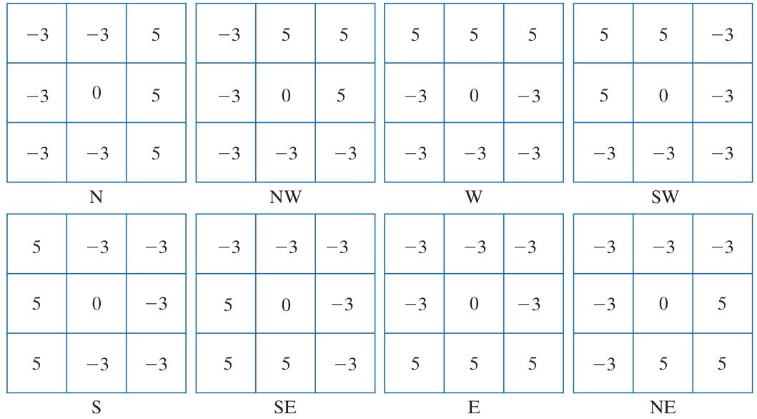
Gradient and it’s Computation - Kirsch compass kernels

Slide 34
Canny Edge Detection
Image Sharpening - Next Class
A powerful Edge Detection Approach,
Deal with it in the Next Class

Slide 35
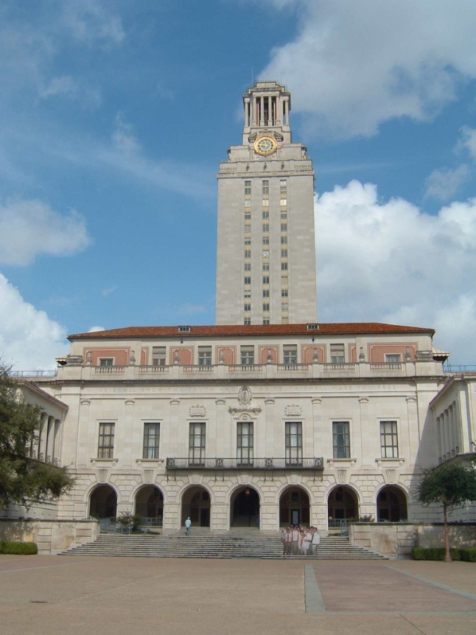
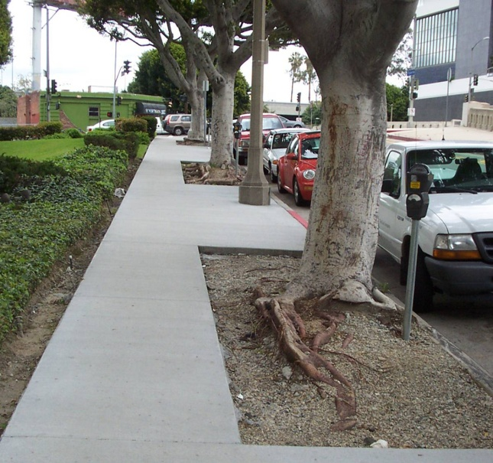
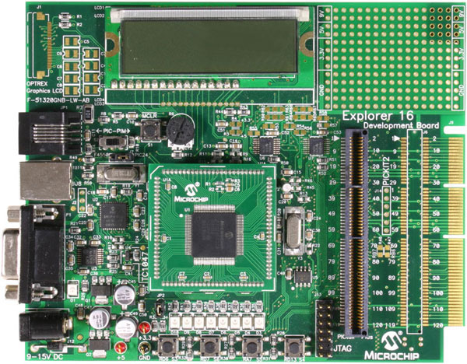
Line Fitting
Many objects characterized by presence of straight lines
Wait, why aren’t we done just by running edge detection?

Slide 36
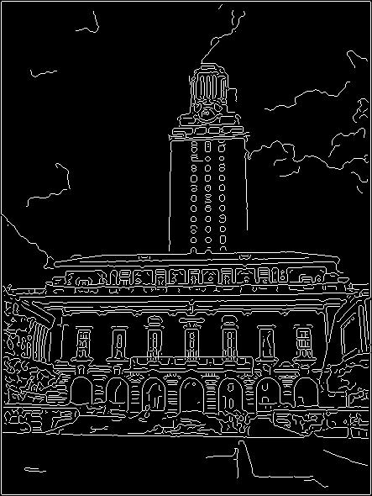
Difficulty in Line Fitting
Extra edge points (clutter), multiple models:
which points go with which line, if any?
Only some parts of each line detected, and some parts are missing:
how to find a line that bridges missing evidence?
Noise in measured edge points, orientations:
how to detect true underlying parameters?
Kristen Grauman

Slide 37
Role of Voting in Line Fitting
It’s not feasible to check all combinations of features by fitting a model to each possible subset.
Voting is a general technique where we let the features vote for all models that are compatible with it.
Cycle through features, cast votes for model parameters.
Look for model parameters that receive a lot of votes.
Noise & clutter features will cast votes too, but typically their votes should be inconsistent with the majority of “good” features.
Kristen Grauman

Slide 38
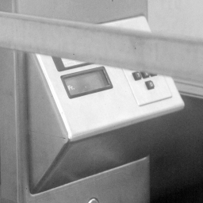
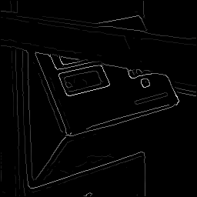
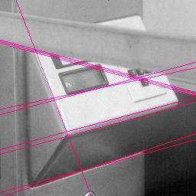
Hough Transform for Line Fitting
Given points that belong to a line, what is the line?
How many lines are there?
Which points belong to which lines?
Hough Transform is a voting technique that can be used to answer all of these questions.
Main idea:
1. Record vote for each possible line on which each edge point lies.
2. Look for lines that get many votes.
Kristen Grauman

Slide 39

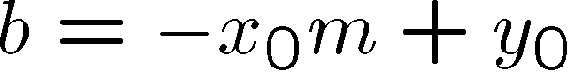
Hough Transform for Line Fitting
Equation of a line?
y = mx + b
y
b
b₀
x
m₀
m
image space
Hough (parameter) space
Connection between image (x,y) and Hough (m,b) spaces
A line in the image corresponds to a point in Hough space
To go from image space to Hough space:
given a set of points (x,y), find all (m,b) such that y = mx + b
What does a point (x₀, y₀) in the image space map to?
Answer: the solutions of b = -x₀m + y₀
this is a line in Hough space
Kristen Grauman

Slide 40
Hough Transform for Line Fitting
Equation of a line?
y = mx + b
y
b
y₀
x₀
x
m
image space
Hough (parameter) space
What are the line parameters for the line that contains both (x₀, y₀) and (x₁, y₁)?
It is the intersection of the lines b = –x₀m + y₀ and b = –x₁m + y₁
Kristen Grauman

Slide 41
Hough Transform for Line Fitting
Equation of a line?
y = mx + b
y
b
x
m
image space
Hough (parameter) space
How can we use this to find the most likely parameters (m,b) for the most prominent line in the image space?
Let each edge point in image space vote for a set of possible parameters in Hough space
Accumulate votes in discrete set of bins; parameters with the most votes indicate line in image space.
Kristen Grauman

Slide 42
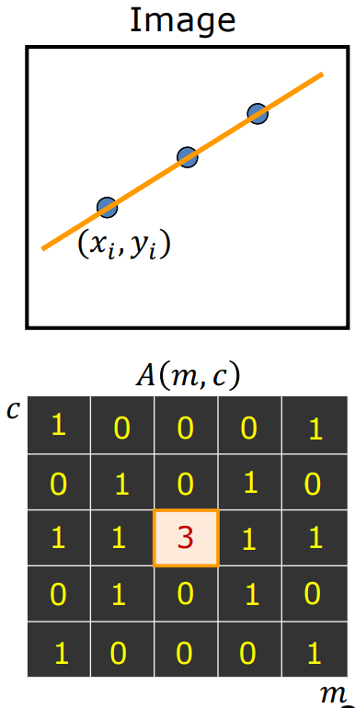
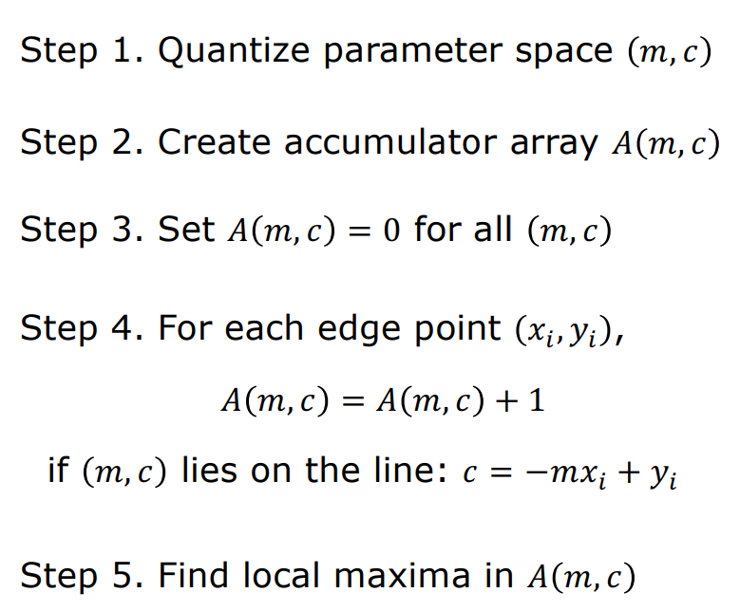
Hough Transform for Line Fitting
CV 4: Edge and Line Detection
Shree K. Nayar

Slide 43
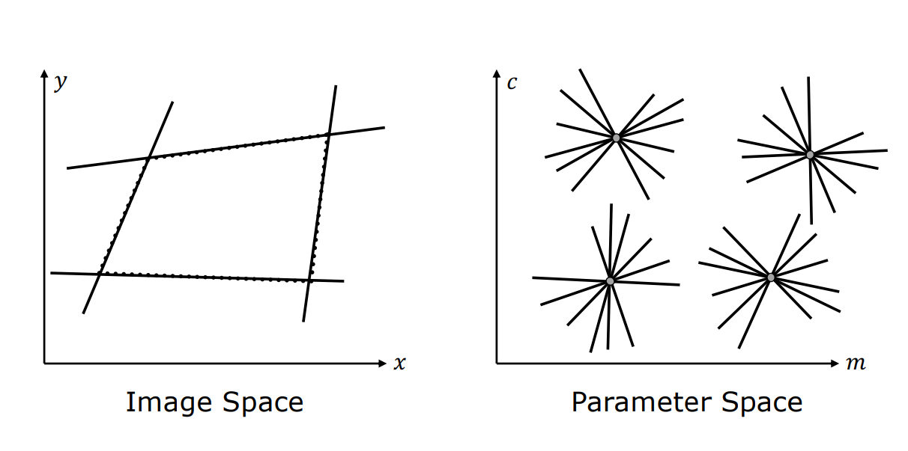
Hough Transform for Line Fitting
Shree K. Nayar

Slide 44
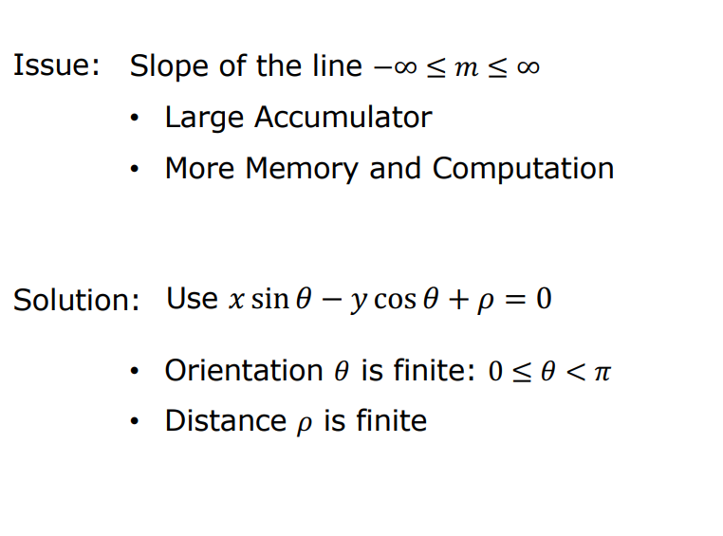
Hough Transform for Line Fitting
Shree K. Nayar

Slide 45
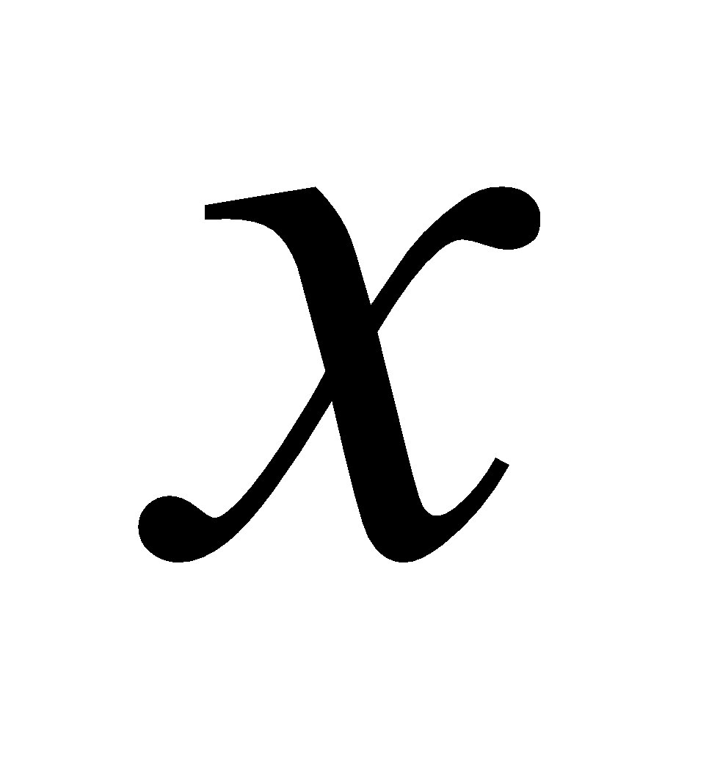

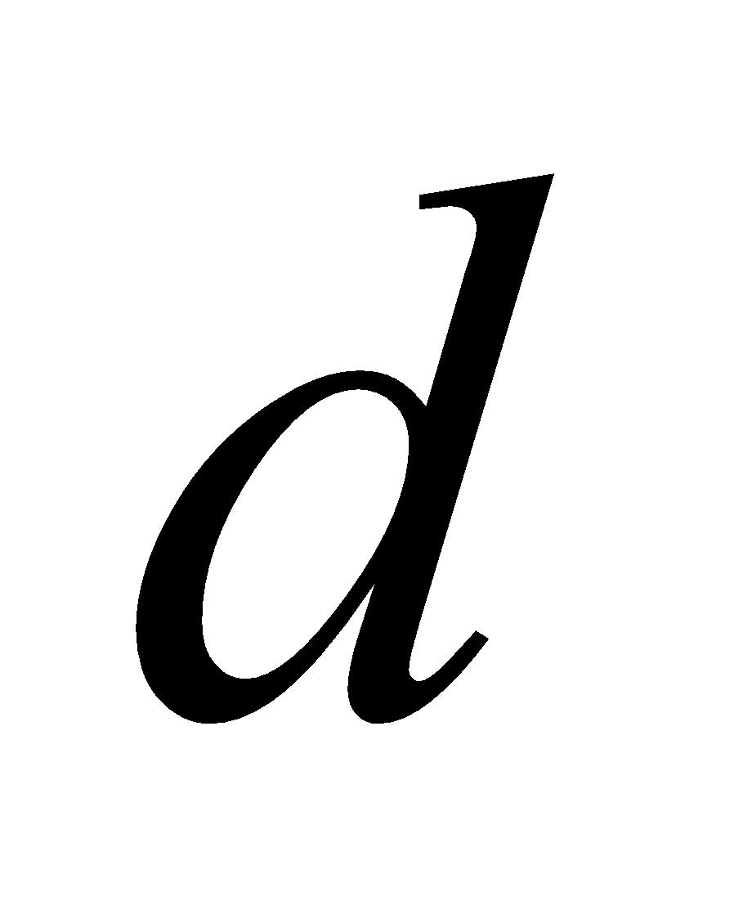
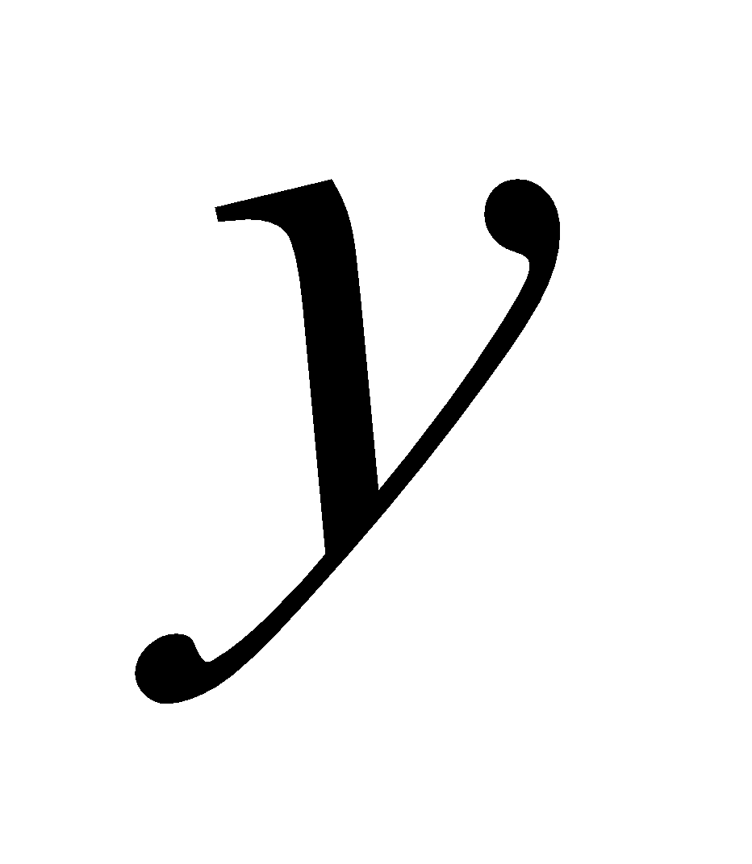
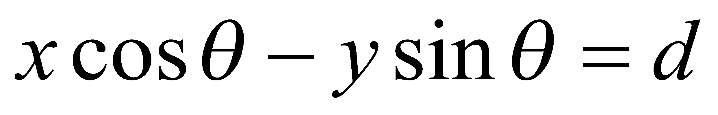
Polar Representation of Lines
Image columns
[0,0]
: perpendicular distance from line to origin
: angle the perpendicular makes with the x-axis
Image rows
Shree K. Nayar

Slide 46
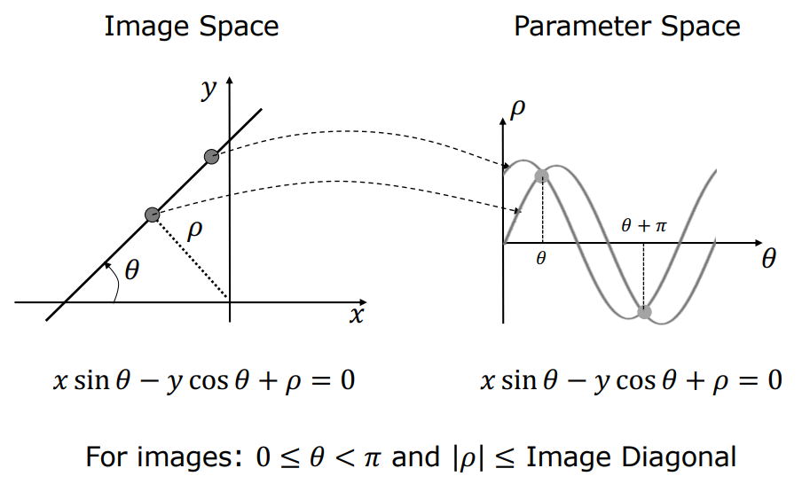
Alternate formulation using Polar Representation of Lines
ⲣ : perpendicular distance from line to origin
Θ : angle the perpendicular makes with the x-axis
Shree K. Nayar

Slide 47

Alternate formulation using Polar Representation of Lines
Shree K. Nayar

Slide 48




Examples - Hough Transform
Kristen Grauman

Slide 49
Readings:
Hough Transform - Page 737 - 742 - Digital Image Processing, 4th Ed, Rafael C. Gonzalez & Richard E. Woods
Next Class:
Image Sharpening; Linear Filters; Edge Detection using Canny; Line detection using Hough transforms; [ if possible]

Slide 50
Thank you

